Slide 1
Employee Data Analysis using Excel
STUDENT NAME: SANKARI M
REGISTER NO: 312219567
DEPARTMENT: B.Com General
COLLEGE: SREE SASTHA ARTS AND SCIENCE COLLEGE
NAAN MUDHALVAN ID: 6BBD01D4989F4D3A89640477D8AB6E1C

Slide 2
PROJECT TITLE
Employee Performance Analysis using Excel

Slide 3


AGENDA
Problem Statement
Project Overview
End Users
Our Solution and Proposition
Dataset Description
Modelling Approach
Results and Discussion
Conclusion
3/21/2024 Annual Review

Slide 4

PROBLEM STATEMENT
Performance evaluations provide a stepping-stone for the employee and supervisor to identify and discuss areas where performance can be improved. It can also be an important opportunity for employee and manager expectations to be reinforced or clarified.

Slide 5

PROJECT OVERVIEW
The primary goal of this project is to analyze and evaluate the performance of employees within the organization using a comprehensive set of metrics. This analysis will help to identify strengths, weakness and areas for improvement facilitating data driven decisions in employee development, training and rewards.

Slide 6

WHO ARE THE END USERS?
Employees
Organization
HR
Employers
Different kind of Industries
IT Sector

Slide 7

OUR SOLUTION AND ITS VALUE PROPOSITION
Filtering – Missing Values
Conditional Formatting – To Highlight Blank Values
Pivot Table
Charts and Graph

Slide 8

Dataset Description
Employee Data set we have 26 features
In that I have selected the following 9 Features
EmpId
GenderCode - Male , Female
Performance Score
BusinessUnit
Name – FirstName, LastName
Rating - Current Employee Rating
EmployeeType
EmployeeStatus

Slide 9

THE "WOW" IN OUR SOLUTION
Executives or managers can get customized, on – the – fly insights into individual, team or department performance with a simple click on the slicers.
Predict future performance trends for employees, allowing HR and managers to proactively support those at risk of declining productivity.
Managers can instantly spot trends and focus on areas needing improvement, without diving into raw numbers.
3/21/2024 Annual Review
9

Slide 10
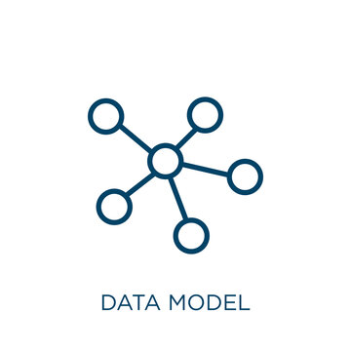
MODELLING
Data Collection – Collection of dataset from Kaggle or collecting own data from real world.
Data Cleaning – Cleaning the data by removing the missing values, Duplicate values and noisy data
Techniques –
Conditional Formatting
IFS
Sort and Filter
Pivot Table and Charts
Slicers
Results – High level performing staffs is low compare to the medium level performing staffs.
10

Slide 11
RESULTS
11

Slide 12
RESULTS
12

Slide 13
CONCLUSION
Employee Performance Analysis Conclusion:
Performance Distribution: The analysis categorizes employees into four performance levels: High, Medium, Low, and Very High. From the chart, it is evident that performance varies significantly across different individuals or groups (represented by abbreviations such as BPC, CDR, EW, etc.).
Top Performers: Employees or groups such as MSC, NEL, SVG, and WB show a higher frequency of Very High and High performance levels, indicating consistent superior output or contributions in these categories.
Moderate Performers: Categories like CDR, PI, and PYZ display moderate performance, with a balanced distribution between Medium and High performance levels. This indicates room for growth and improvement but no critical performance issues.

Slide 14
CONCLUSION
4. Low Performance: BPC and PI seem to show notable Low performance metrics compared to others. This suggests the need for targeted interventions such as training, coaching, or workload adjustments to enhance their productivity.
5. Insights for Improvement: The analysis clearly highlights areas of success and concern. Focus should be placed on supporting low-performing individuals while maintaining and leveraging the strengths of high performers. Tailored development programs could be implemented to boost overall performance consistency across the board. By addressing the gaps in performance and nurturing high potential, this analysis offers a data-driven approach to optimize workforce productivity.

